Slide 1
BSL Level 1 Unit 102
FAMILY

Slide 2
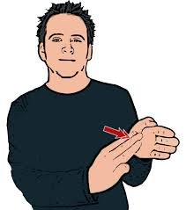
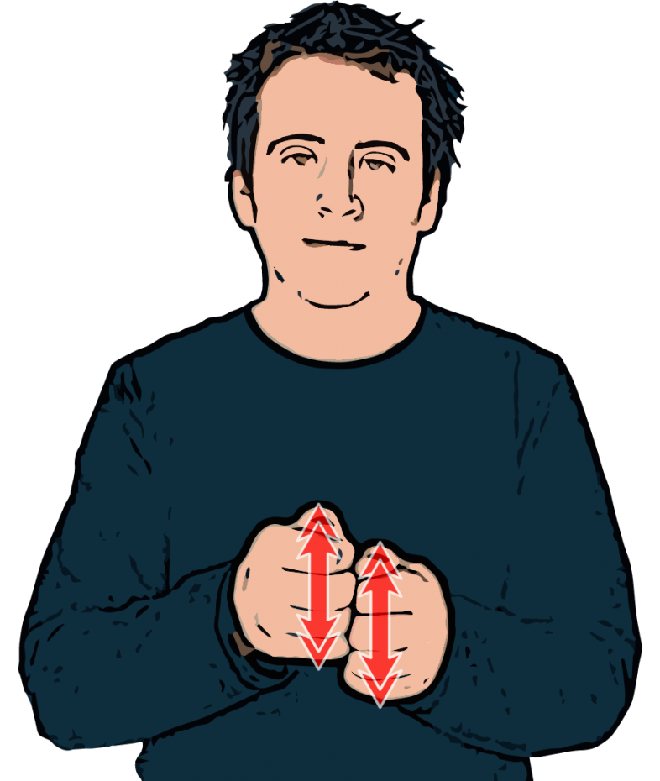
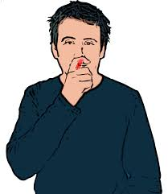
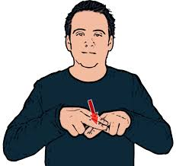
Relatives
Brother
Mum
Sister
Dad

Slide 3
Relatives
Mum / Mother
Dad / Father
Son
Daughter
Brother
Sister
Nan / Grandmother
Grandad / Grandfather
Aunt
Uncle
Niece
Nephew
Cousin
Carer
Baby
Family

Slide 4
Families
Married
Divorced
Husband
Wife
Boyfriend
Girlfriend
Engaged
Partner
In law
God son / daughter
Step
Half
Foster
Adopted

Slide 5
Describing family
I have 2 sisters, one is older, one is younger
My brother is short, thin and wears glasses
My grandmother is very old, she’s 92
My brother goes to college
My cousin works in a shop
My dad is really tall, has curly hair and a beard

Slide 6
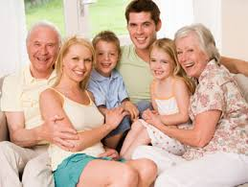
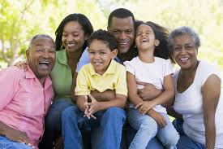
Describe the family

Slide 7
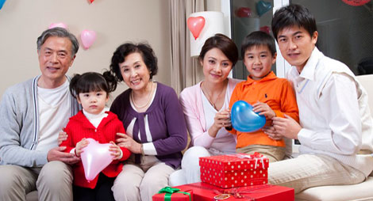
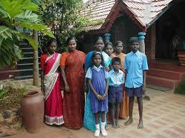
Describe the family

