Slide 1
BSL Level 1 Unit 102
COLOUR, SHAPE & SIZE

Slide 2
COLOUR
Red
Blue
Green
Yellow
Black
White
Grey
Gold
Silver
Pink
Orange
Purple

Slide 3
SHAPES
Square
Diamond
Rectangle / Oblong
Circle
Star
Oval
Triangle
Heart

Slide 4
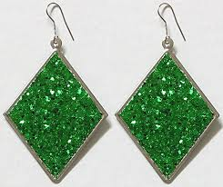
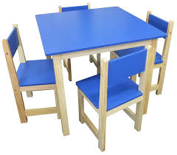
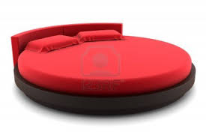
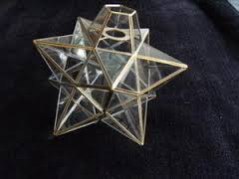
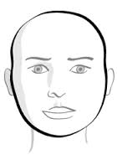
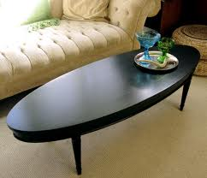
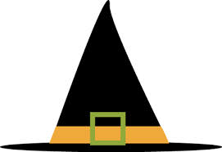
Descriptions

Slide 5
SIZES
Medium
Thin
Slim
Wide
Narrow
Baby
Child
Teenager
Young
Old
Middle-aged
Short
Tall
Small
Big
Long
Short
Tiny
Massive
Fat
Stocky

Slide 6
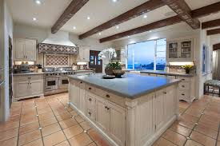
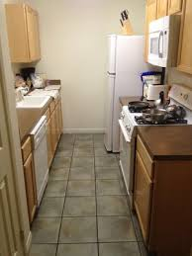
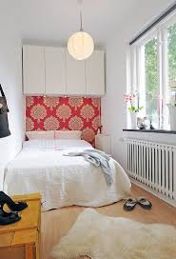
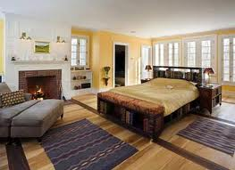
DESCRIPTIONS

Slide 7
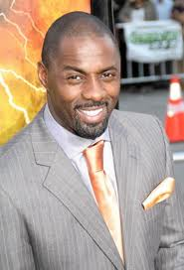
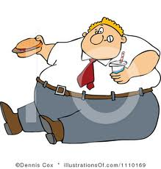
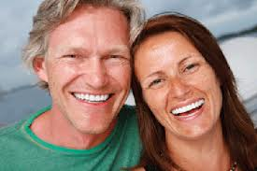
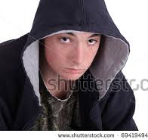
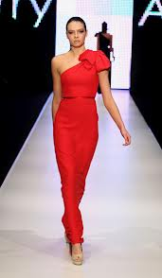
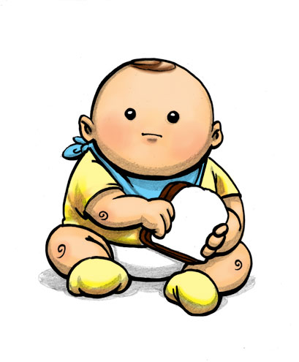
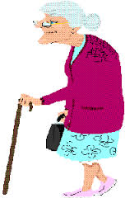
DESCRIPTIONS

