Slide 1
‘Weather’ BSL Level 1 Unit 101

Slide 2
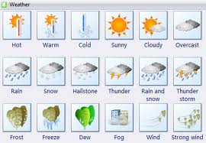
What’s the weather like today ?

Slide 3
Weather situations
It’s raining today
The weekend is going to be sunny
Snow is on its way next week
Oh no, it’s a thunderstorm
It’s very, very windy
It was sunny, now it’s cloudy

Slide 4
Questions and responses
Try these using BSL
Weather holiday what ? – Really very hot (NMF)
Weather tomorrow what ? – Raining all day (NMF)
Temperature today what ? – Its so cold its -4 degrees (NMF)
Sunny, we have football, raining what ? – heavy rain then football cancelled (NMF)

Slide 5
PRACTICAL
I am going to ask you questions relating to weather situations, you will need to think of your own answer.
This will improve your productive and receptive skills in BSL

