Slide 1
‘Directions’ BSL Unit 101

Slide 2
Where ?
Can you show me where …. ?
Left
Right
Straight on
Upstairs / Downstairs
Under / Over
Round the corner

Slide 3
Giving & explaining directions
The ladies toilet is upstairs on the second floor, then turn left
The lift is on the right
Go to the second floor
The bank is 3rd on the right, then 1st left
Go straight ahead and then left at the traffic lights
Where is the fire exit ?

Slide 4
Giving & explaining directions
In BSL version - Try and see if you can sign these ?
(The) ladies toilet (is) upstairs on (the) second floor, (then) turn left
(The) lift is on (the) right
Go to (the) second floor
(The) bank 3rd right, (then) 1st left
Go straight ahead (and then) left (at the) traffic lights
Fire exit where ?

Slide 5
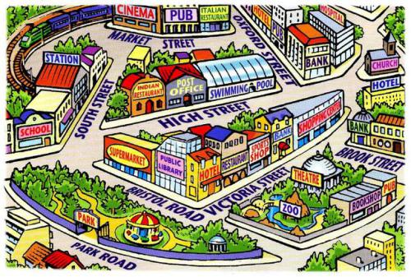

Slide 6
QUESTIONS
How would you get from the zoo to the cinema ?
I am in Park Road, where is the bank on Brook Street please ?
Explain how to get to from the station to the pub in Park Road
I’ve just got off a train, where is the hospital ?
I’ve come out of the park, and I need a swim, where do I go ?

