Slide 1
‘Transport’
Unit 101

Slide 2
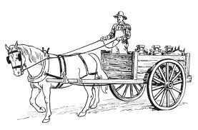
Modes of transport
Train Bus Tram Coach
Lorry Van Taxi Car
Bike Motor-bike Aeroplane Boat

Slide 3
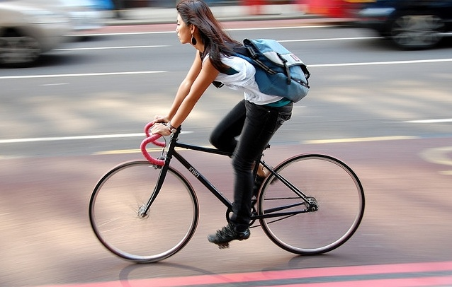
Bike
.
This is signed as pedal

Slide 4

Motorbike
(Twist your wrist x2)

Slide 5

Walk
Signed as ‘one hand is the floor, the other hand does the walking’

Slide 6
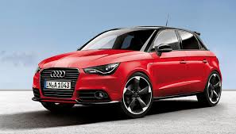
‘Car’
Imagine you have a steering wheel in your hands

Slide 7
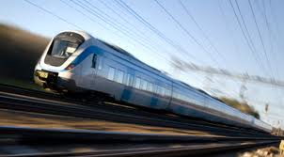
‘Train’
Fist clenched move your arm forward fast.

Slide 8
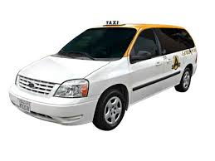
‘Taxi’
Click your fingers as you would hail a cab

Slide 9
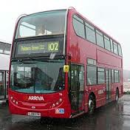
‘Bus’
Ding ding – fares please !! (If you’re old enough to remember!!)

Slide 10
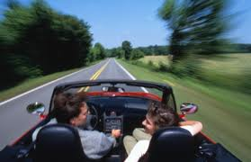
‘Drive’
Hands on steering wheel and move your arms forward

Slide 11
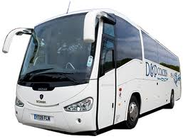
‘Coach’
Fist shaped ‘c’ both hands move apart

Slide 12
Questions ??
Using your BSL signs learned last week
Work in pairs asking questions including transport –
Arrive work how ?
Bus, how long ?
Train, what time ?
Coach, how much ?
Walk, how long ?

