Slide 1
‘Telling the time’
Level 1 – Unit 101

Slide 2
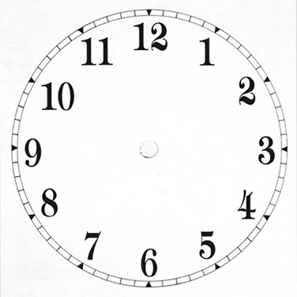
‘Clock Face’
O’Clock
Quarter to
Quarter Past
Minute
Second
Hour
To
Past
1 O’clock
10 O’clock
(Twist hand)
11 O’clock
12 O’clock
Tap x 2 for day
Flick once for night
Half Past

Slide 3
Time to practice
Wake up what time ?
Bath/shower what time?
Leave home what time?
Catch train/bus what time ?
Travel how long?
Arrive work/school what time ?
Finish work/school what time ?
Eat dinner what time ?
Bed what time ?
Stuck traffic how long ?
Lesson start what time ?

