Slide 1
Sports, Hobbies and Activities
BSL Level 1
Unit 102

Slide 2
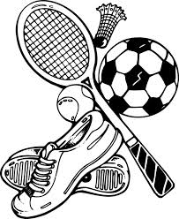
Sports
Game
Match
Set
Score
Won
Lost
Tournament
Result
Competition
Race
Trophy
Medal
Football
Tennis
Cricket
Basketball
Athletics
Rugby
Badminton
Squash
Motor -racing

Slide 3
Sports
Football - score, league, top, middle, bottom, ref, linesman, sub, manager
Tennis - Game, set match, service, umpire
Cricket – bowlers, batsmen
Athletics – 100m, 200m, 1500m, field, sprint
Rugby – score, tries, scrum, touchline, conversion
Badminton – shuttlecock , racket
Swimming – cap, goggles, costume, trunks, crawl, breast-stroke
Motor Racing – F1, motor-cross, speedway, banger racing, helmet,

Slide 4
Activities & Hobbies
Swimming
Table tennis
Snooker / Pool
Fishing
Golf
Reading
Cinema
Bowling / Ten Pin
Deaf Club
Darts
Horse Riding
Dancing
Singing
Youth Club
Running
Music Club
Photography
Rounders
Ice skating / Ice Hockey
Bingo

Slide 5
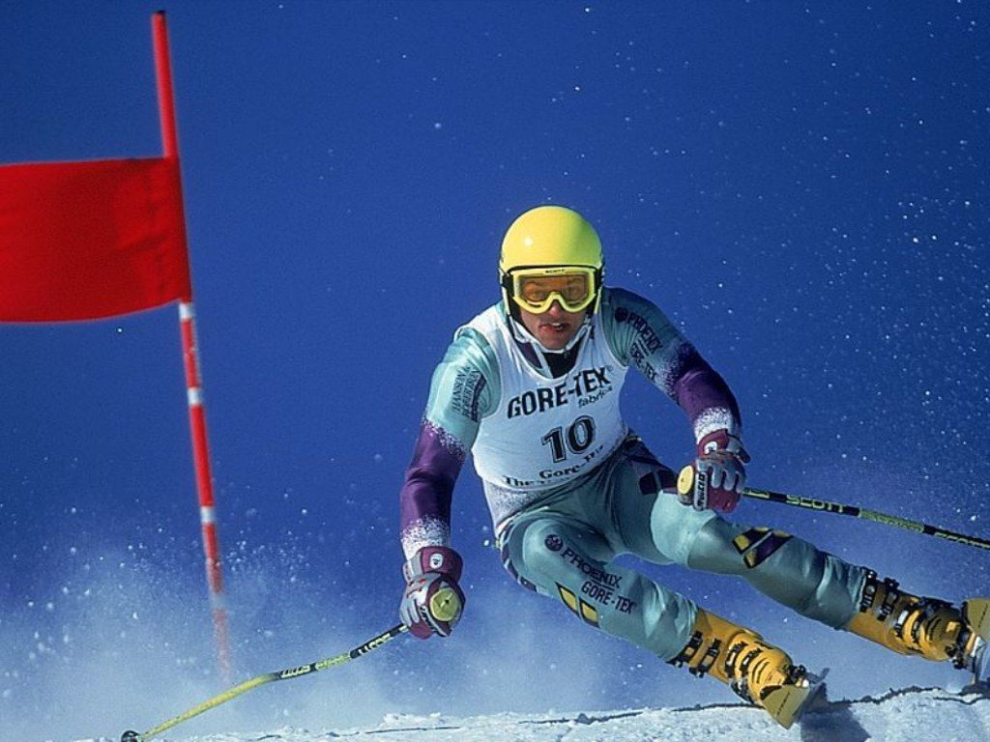
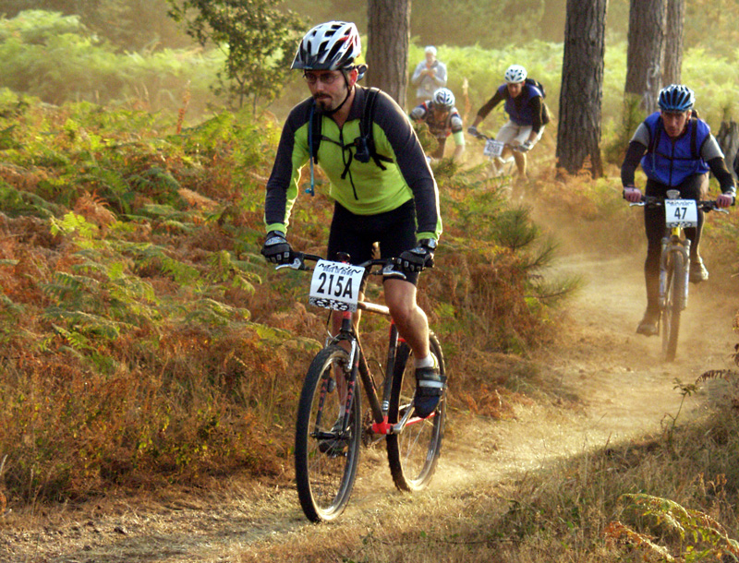
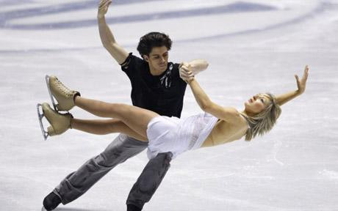
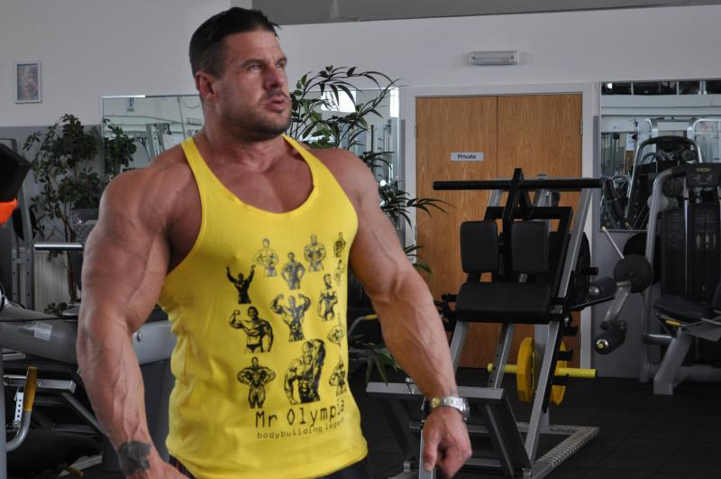
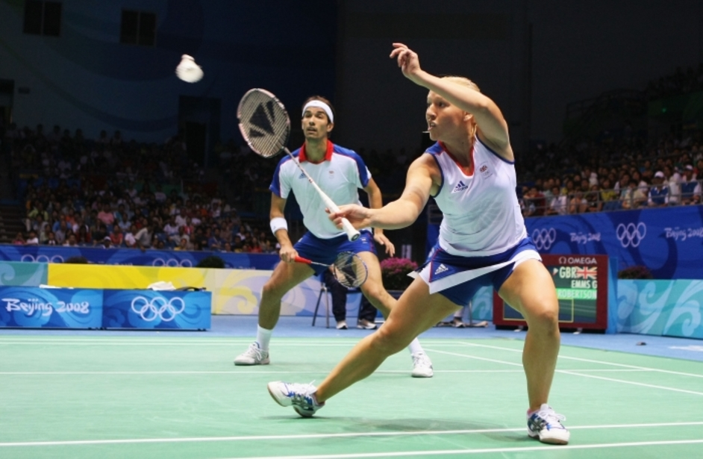
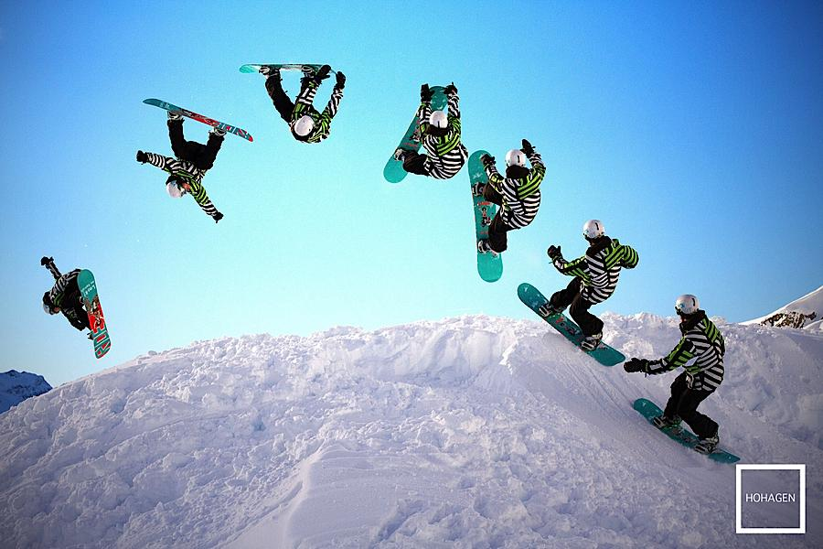
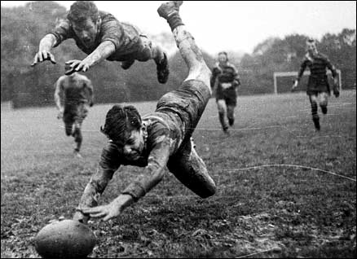
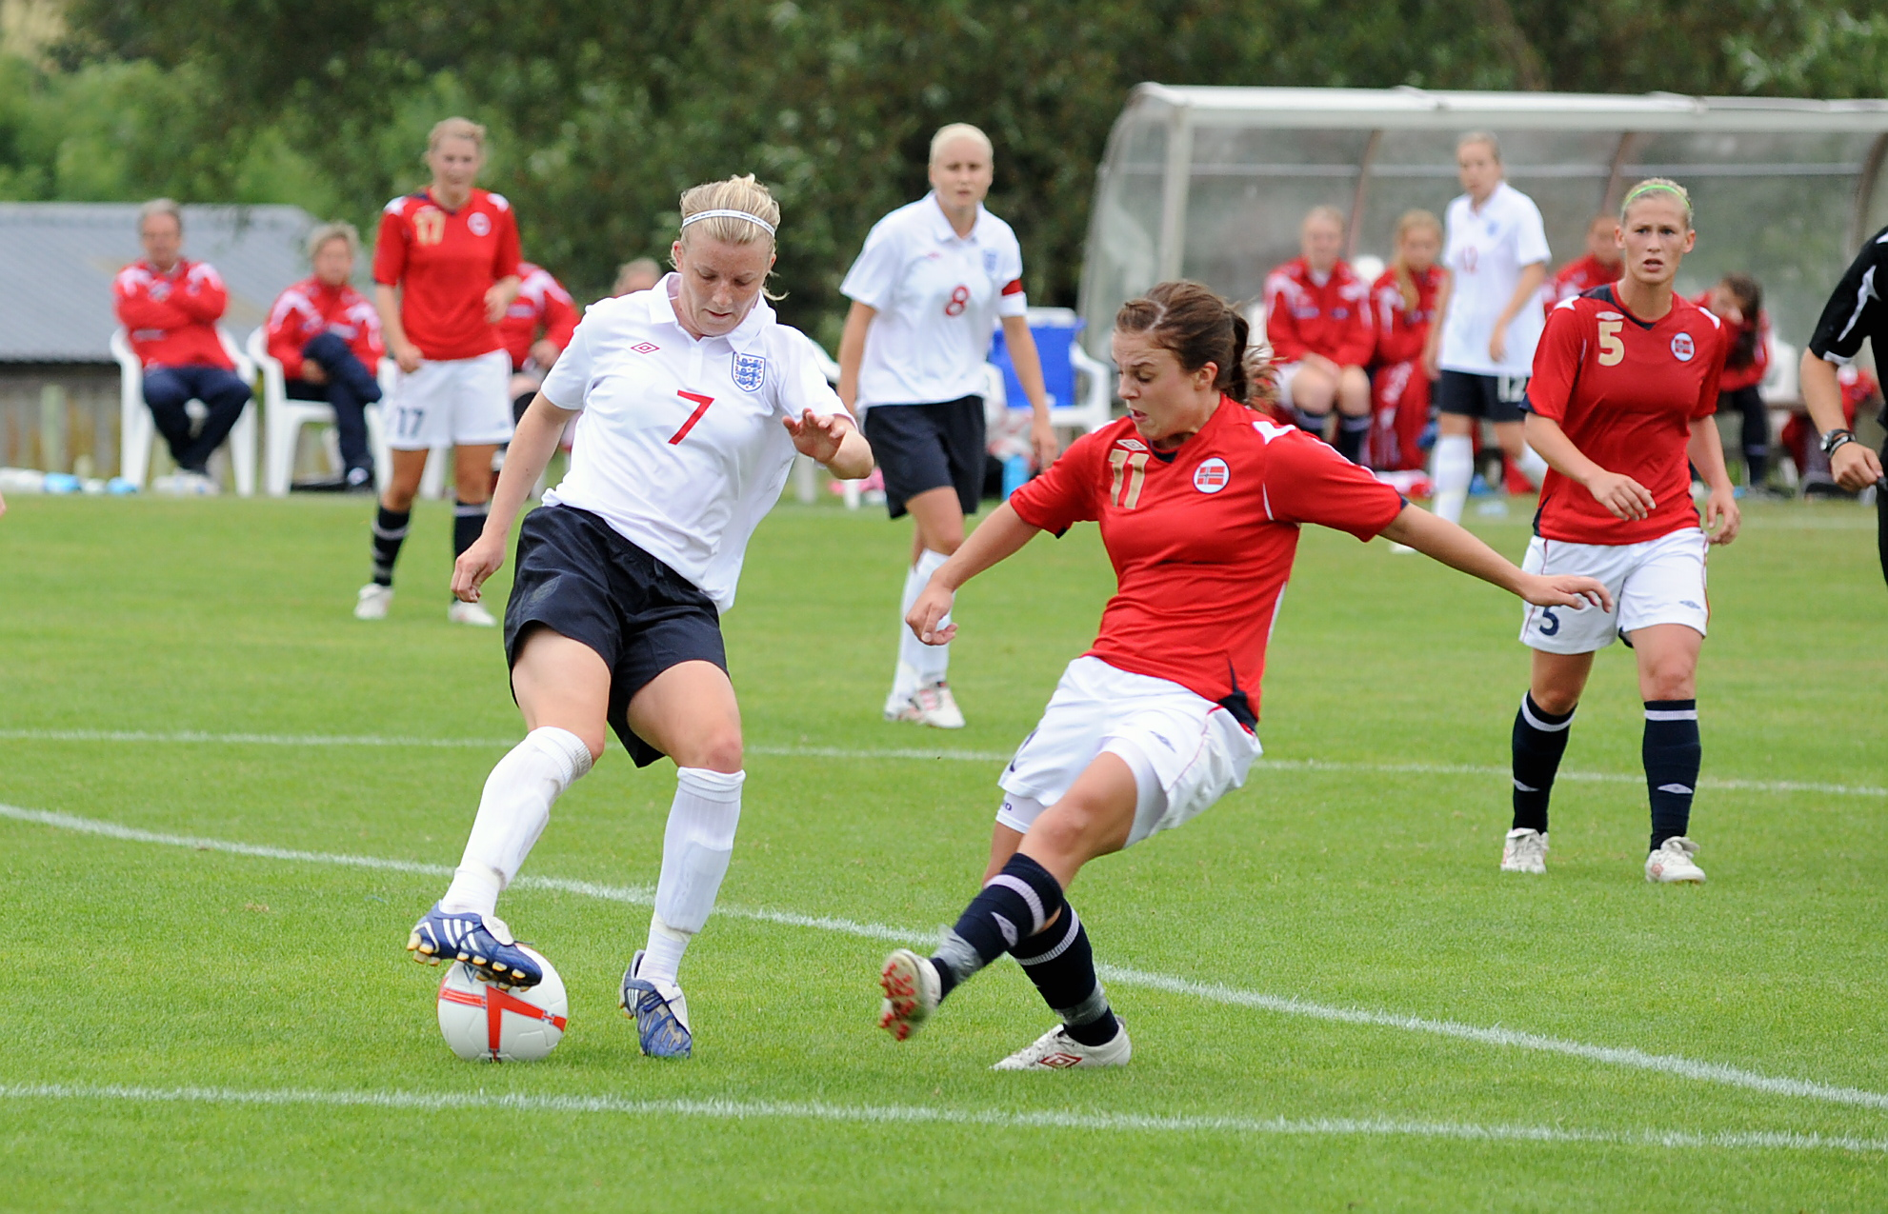
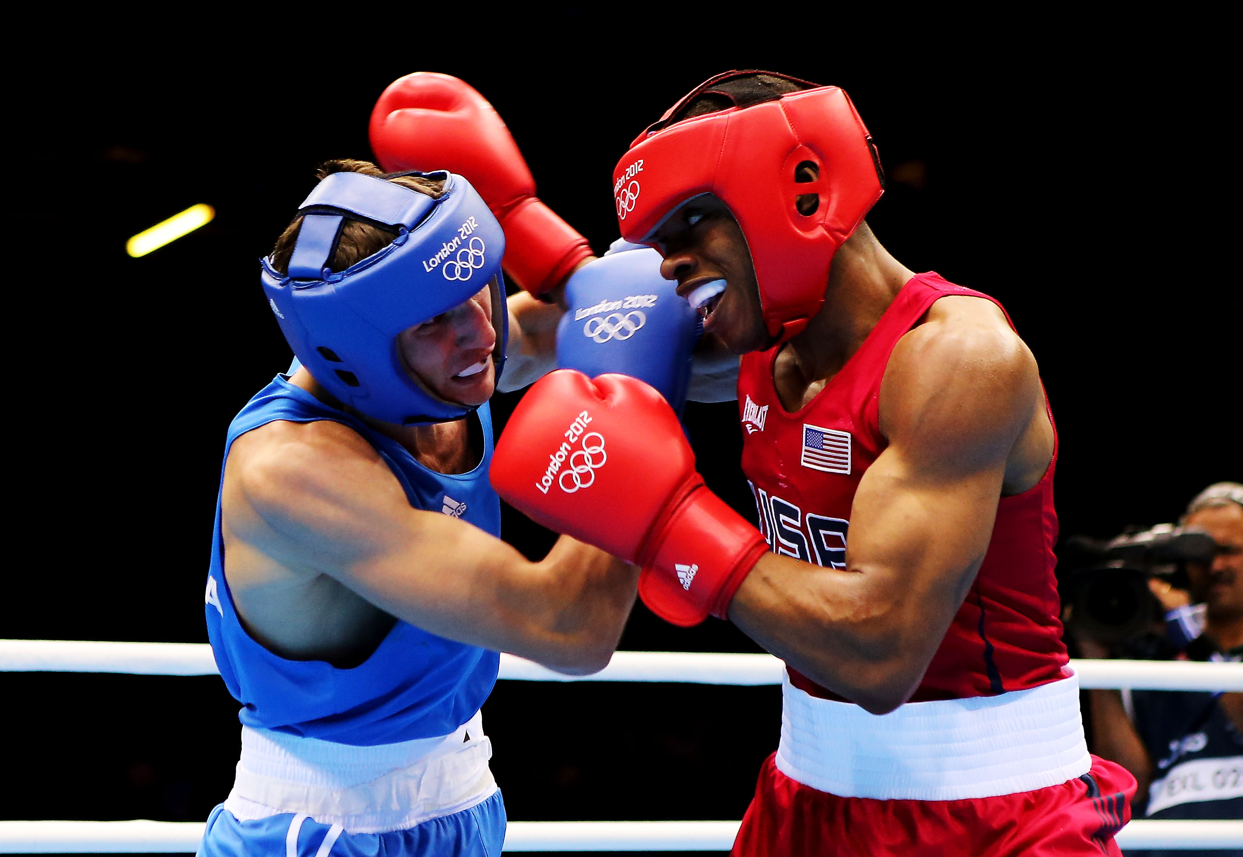
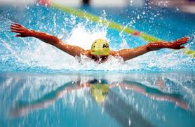
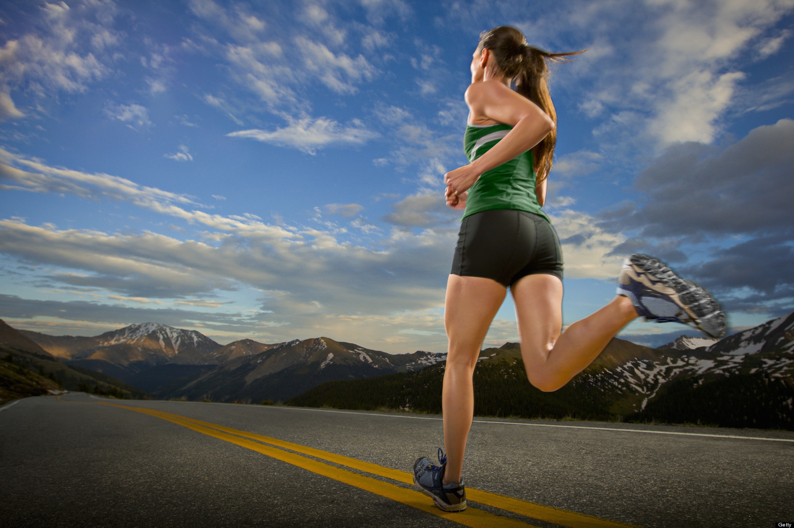
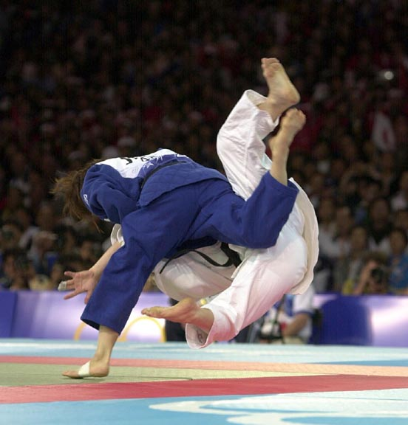
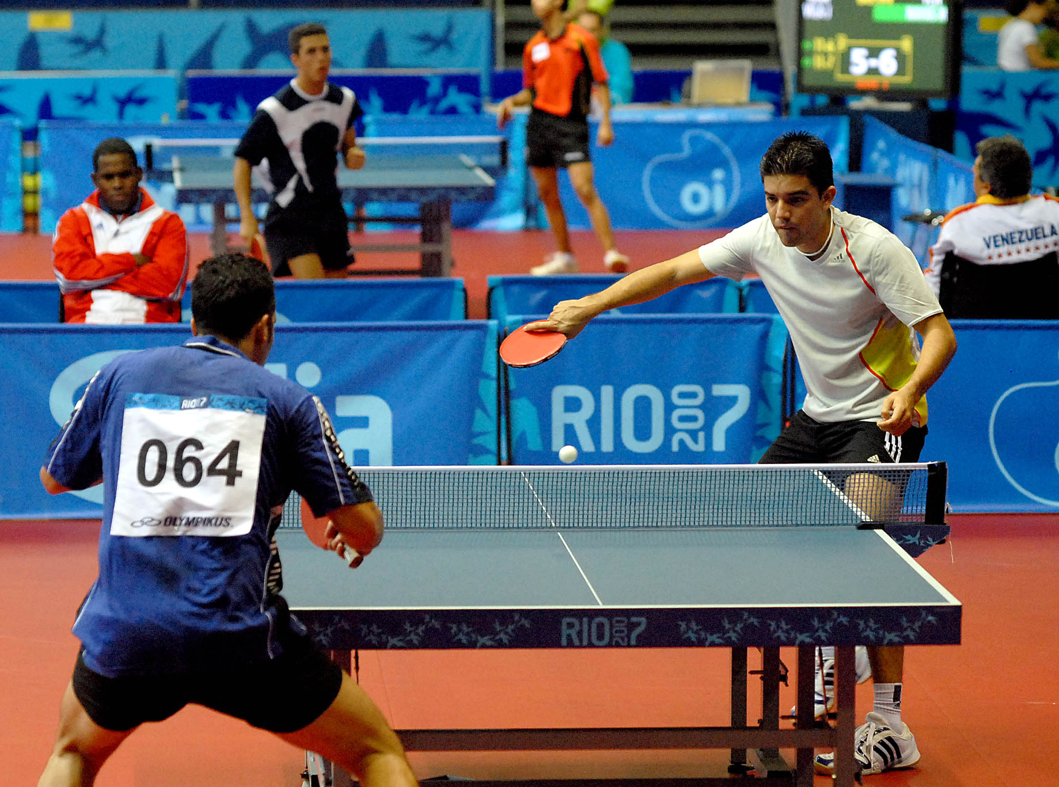
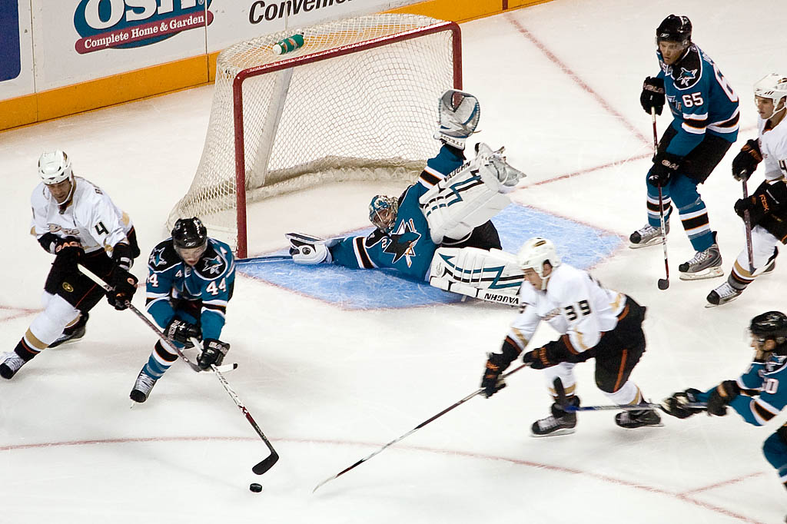
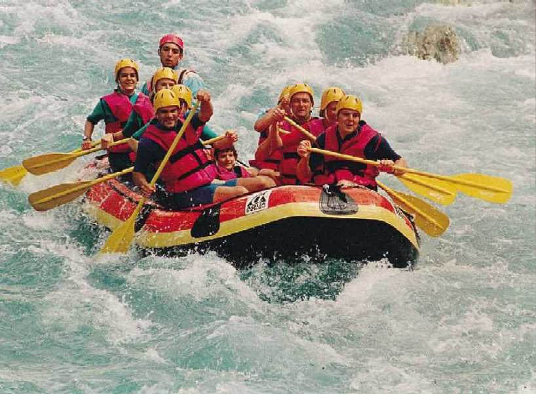
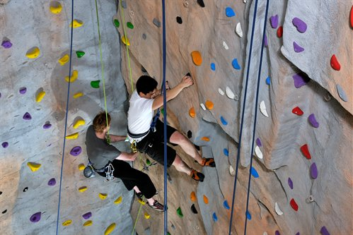
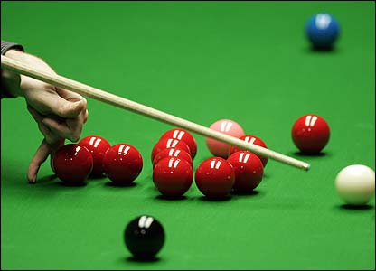
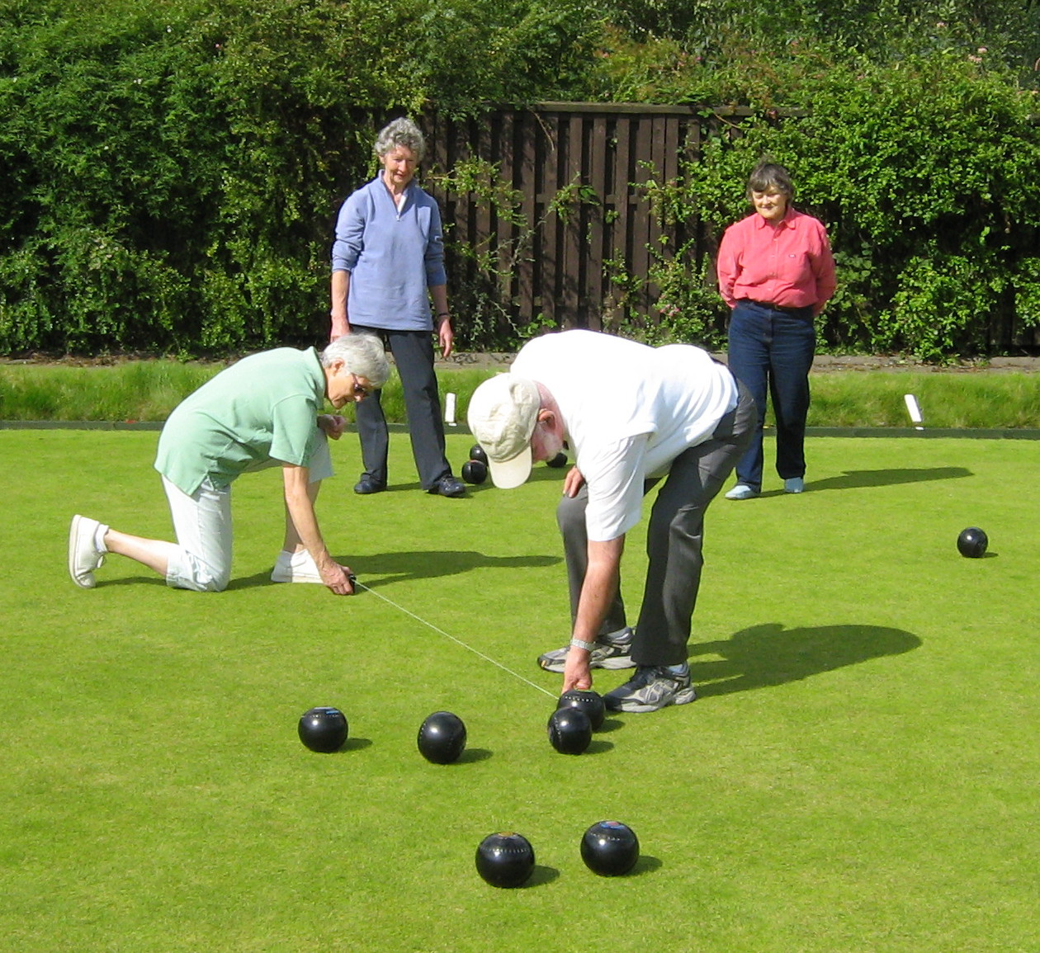
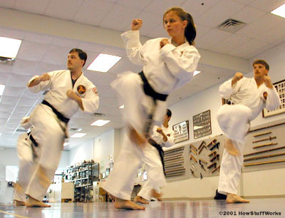
Sports

Slide 6
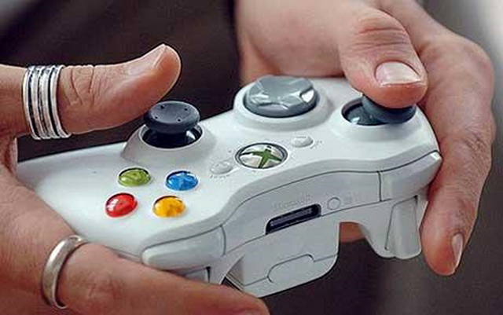
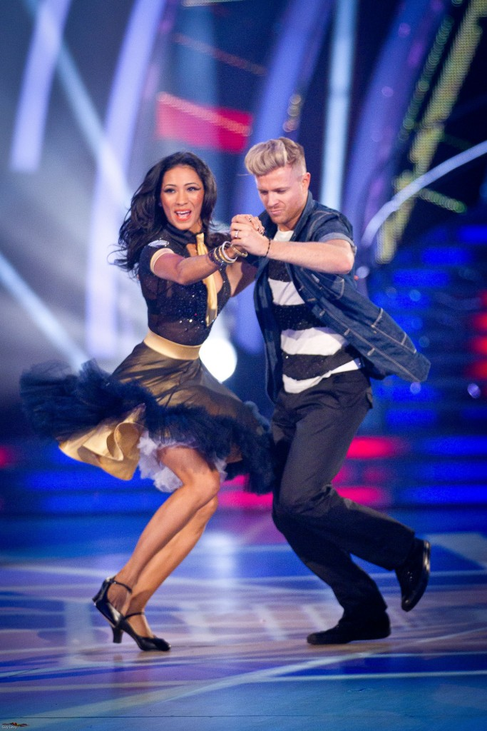
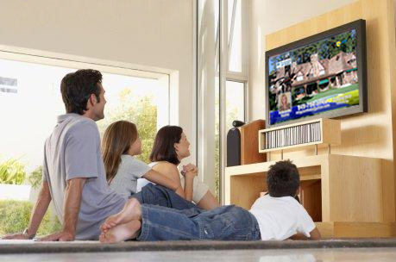
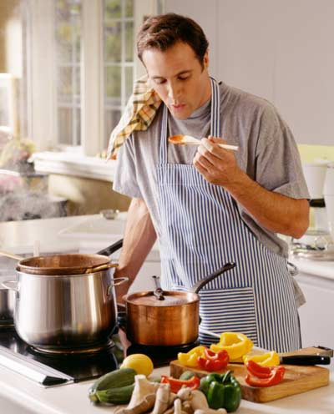
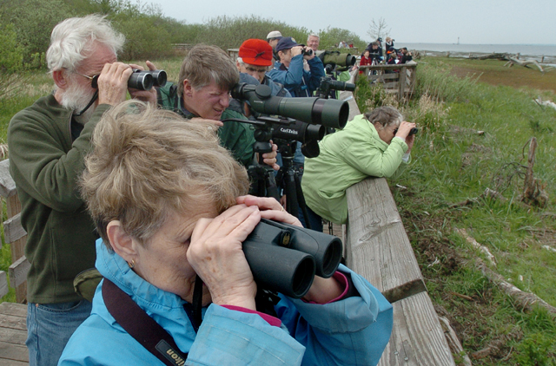
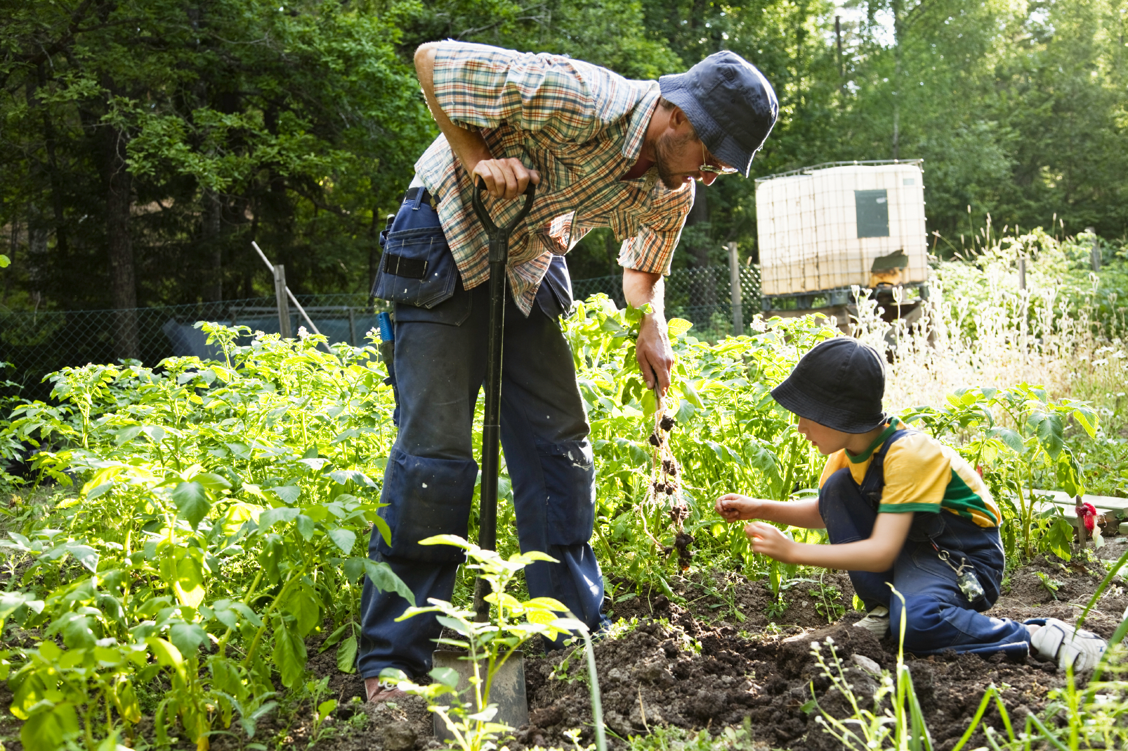
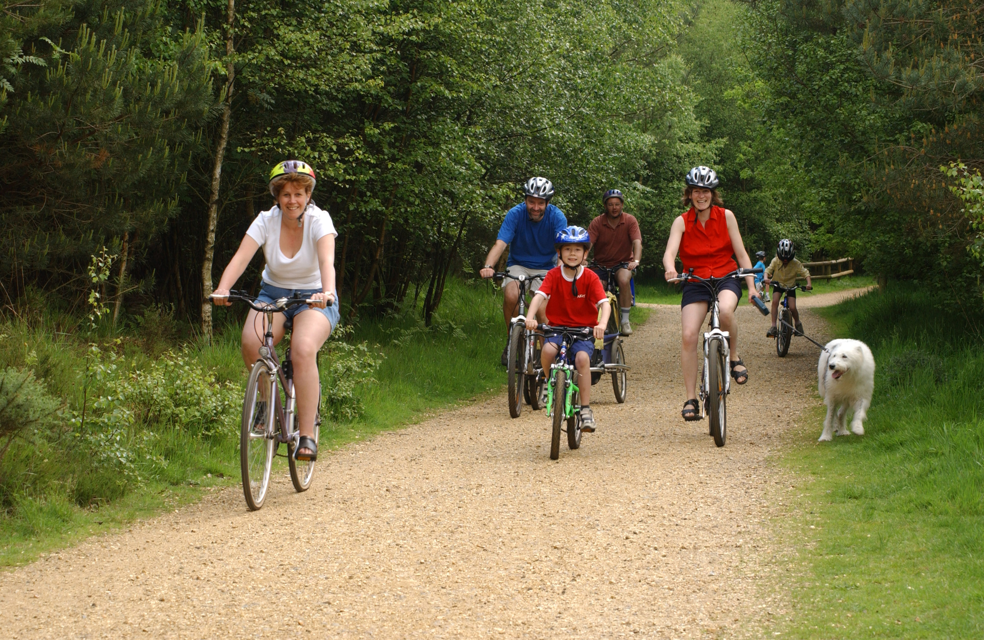
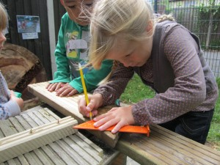
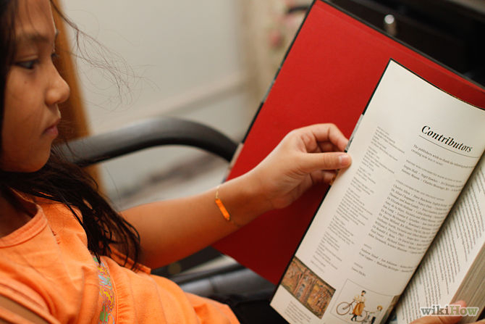
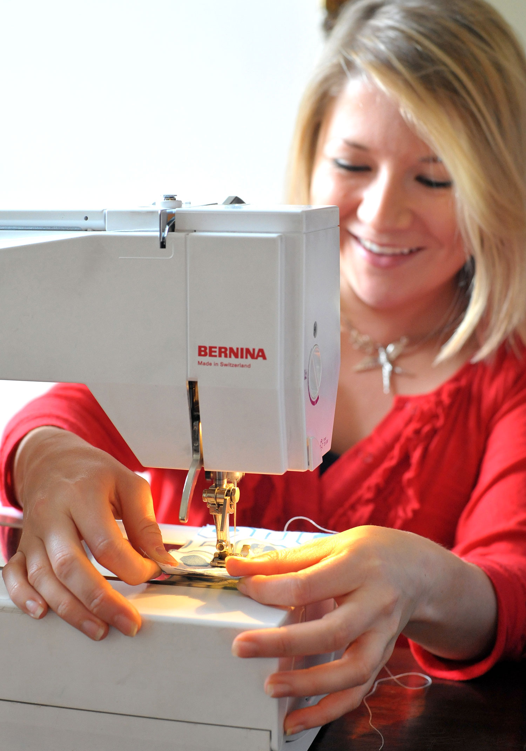
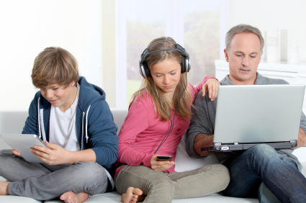
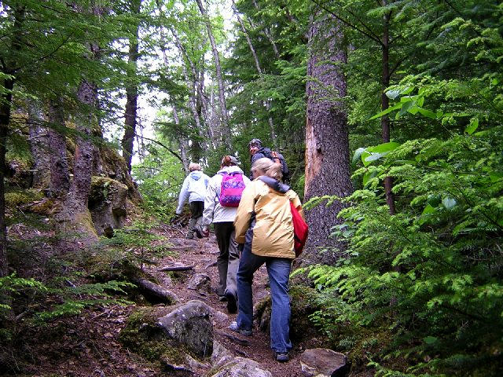
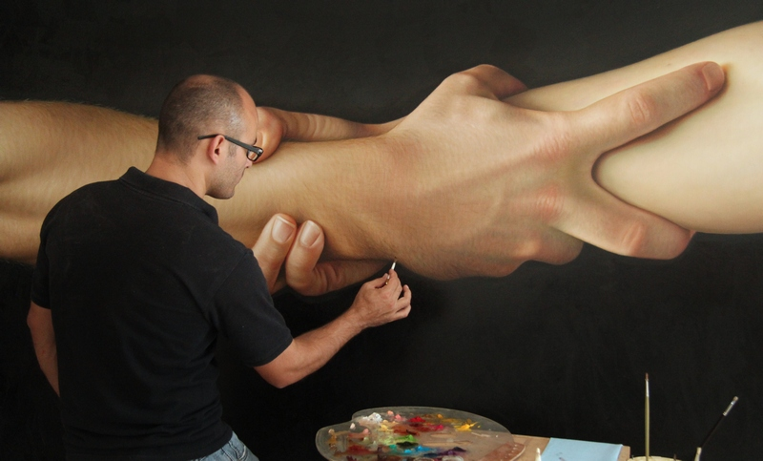
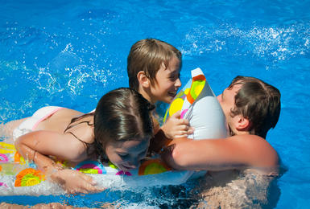
Hobbies at home
Hobbies at home what ?

Slide 7
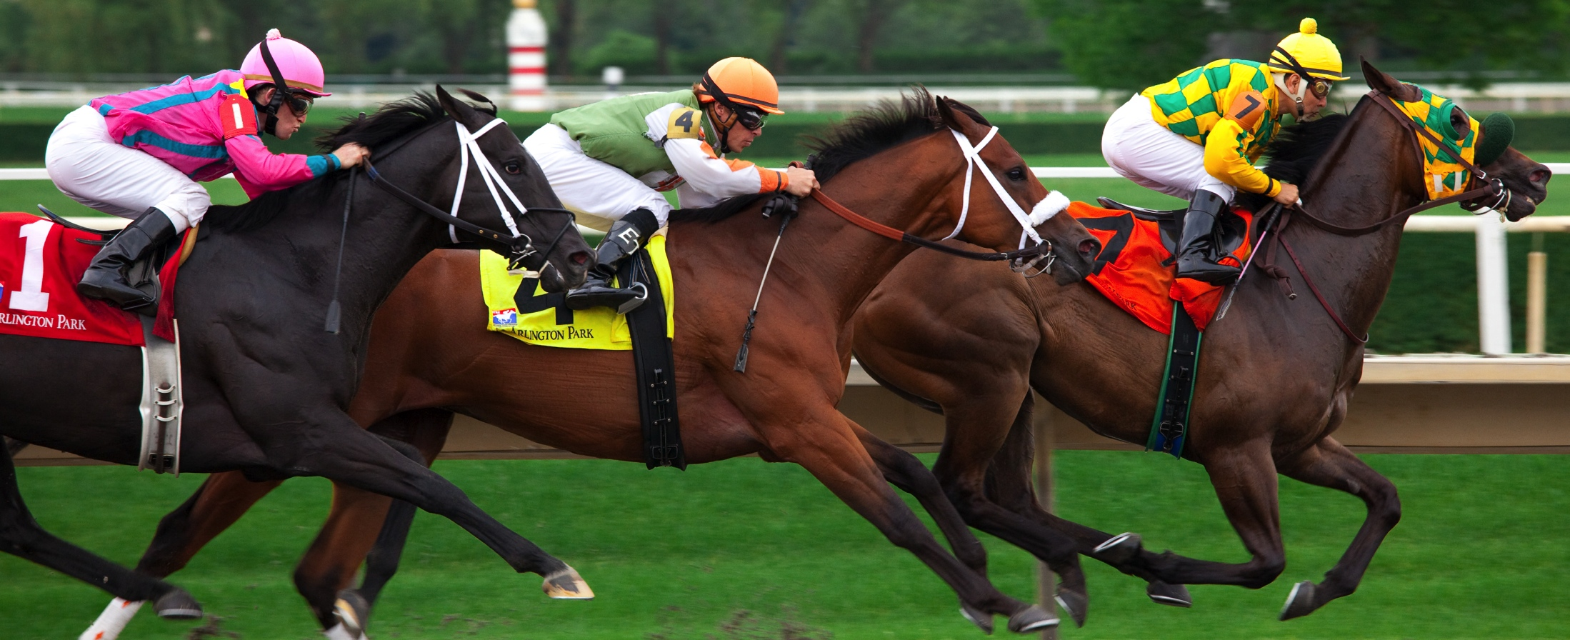
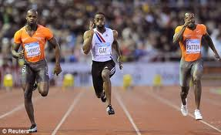
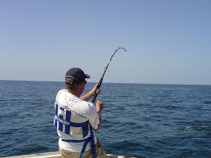
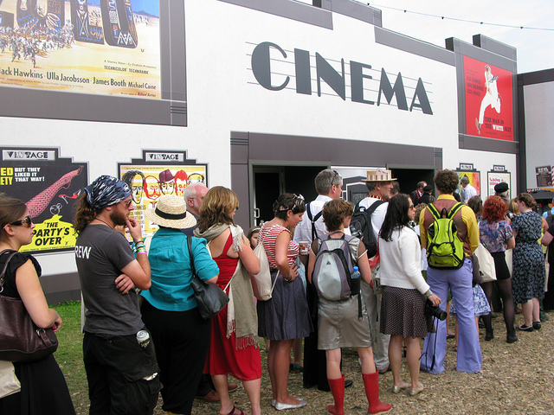
Describe the scene

Slide 8
Practical
I play tennis every Sunday morning
I love football and watching my team win
He lost the tennis by 2 sets
What was the score on Saturday ?
I go swimming on Tuesday evenings
Friday is dance class day

