Slide 1
‘Using Numbers’

Slide 2
‘Rules of counting numbers’
There are rules to using numbers in BSL hand-shape and placement are important.
2
1 ? 3 4 5 6 7 8 9
What wrong with these notes ?
There are different rules of numbers for :
People / Animals
Time
Money
Dates / Days / Months and Year.
These will be taught in the meantime, you will learn more about number sequences later.

Slide 3
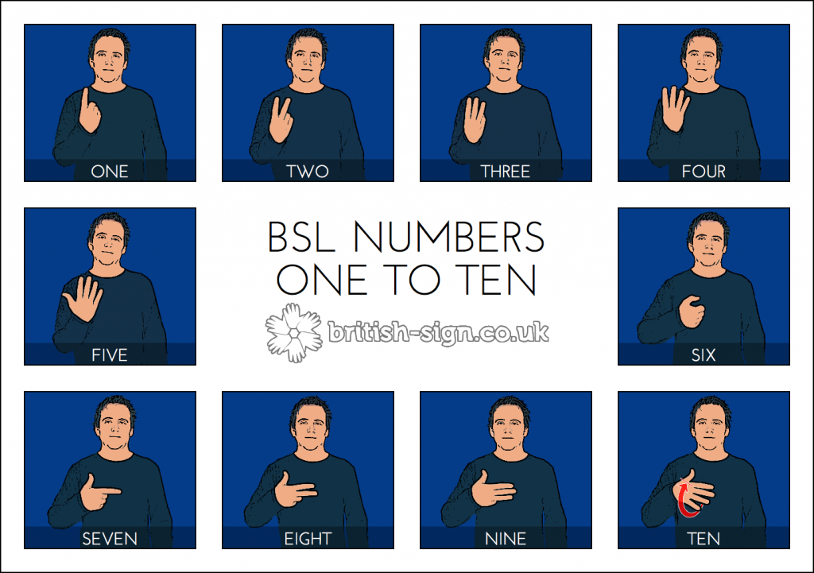
‘Counting Numbers’

Slide 4
‘Questions Using Numbers’
How many ?*
How much ?*
How old ?*
How long ?*
How far ?*
How tall ?*
Equal what ?
Birthday when ?
How big ?*
How heavy ?*
Year group what ?
What time ?*
Some of these phrases are one sign only*. This is called ‘multi-channel’ you will learn more about this later.

