Slide 1
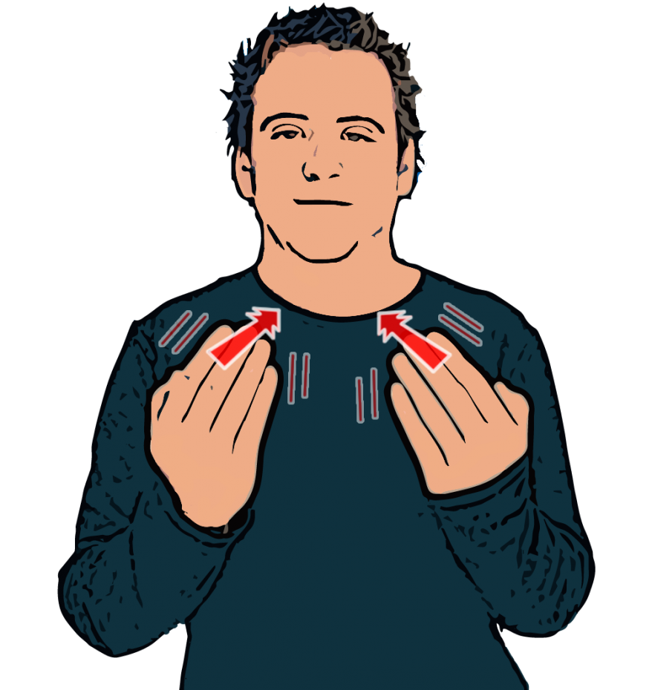
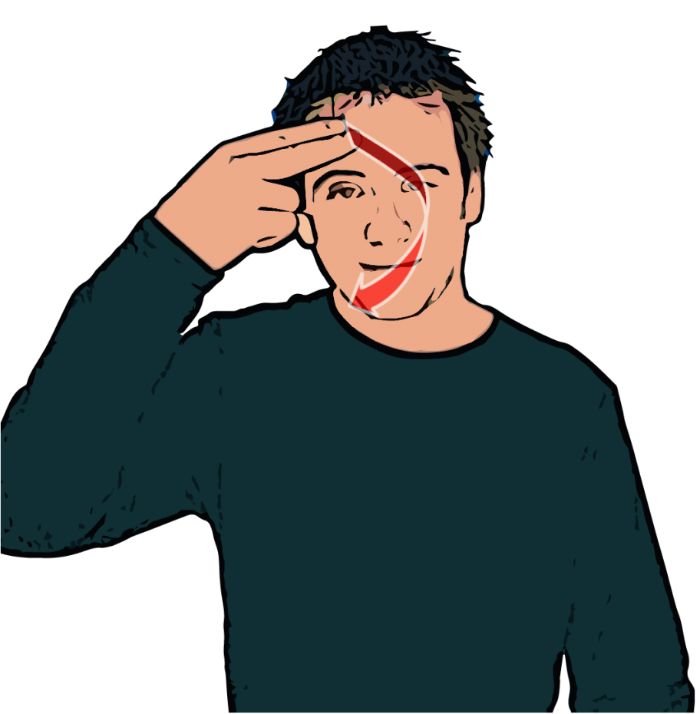
Meeting & Greeting
Using BSL
Unit 101

Slide 2
Greetings
Hi / Hello / Hi ya!
How are you ?
Welcome back!
Haven’t seen you for ages!

Slide 3
Responses
Same as Greetings
I’m fine thank you or I am ok thanks.
Where have you been ?
(REMEMBER TO USE FACIAL EXPRESSIONS)

Slide 4
Leave Taking
Ending a conversation politely
Bye ……
Nice to see you
Nice to meet you
I have to go
Must go now as I am late for……
See you later
See you soon
See you tomorrow
See you next week

Slide 5
Practical
Find a partner and try to do some greeting and leaving to each other in sign with facial expressions. No voices!
Be confident you should act like you haven't see this person for a long time.
Role playing a two way conversation is part of your exam.

