Slide 1
BSL Level 1 Unit 102
Describing Animals

Slide 2
Pets
Dog
Cat
Hamster
Guinea Pig
Horse
Pony
Snake
Lizard
Mouse
Rabbit
Fish
Goldfish
Spider
Budgie
Parrot
Chickens

Slide 3
Fish
Hamster
Bird
Rabbit
Mouse

Slide 4
Descriptions
Big
Tall
Tiny
Small
Fluffy
Hairy
Long bushy tail
Short tail
Teeth
Pointed ears, long ears
Colours
Shape / size
Spots / Pattern
Paws, claws
Shiny
Sweet / cute
Bark / Miaow
Vicious / growling

Slide 5
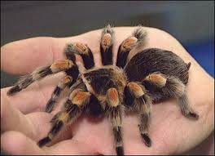
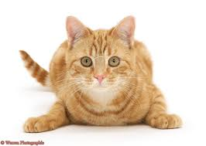
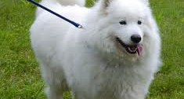
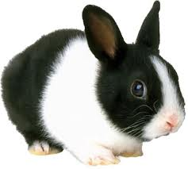
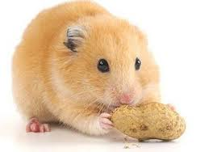
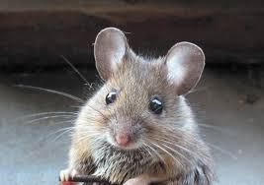
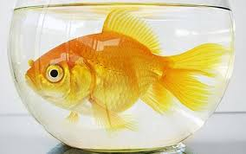
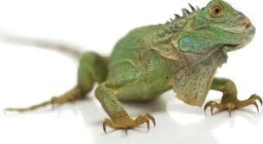
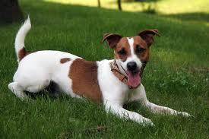
Describing your pet

